Slide 1



POSCO International CRM Innovation TF
User Guide Book_Order & Fulfillment
2025. 10

Slide 2
Contents_PC
Step 1
Credit Management
Credit Information Overview 1.1 Customer Credit Information Check
Step 2
Order Management
POSCO Customer Mapping 1.1 POSCO End-Customer Mapping
POSCO Confirmed Order List 2.1 POSCO Sales Order List
Sales Order Fulfillment Monitoring 3.1 Order/Production Status Tracking
Delivery & Shipment Status Monitoring 4.1 Delivery and Shipment Status Overview

Slide 3
Contents_PC
Step 3
Reporting & Performance
Delivery Performance Report 1.1 Monthly Delivery Performance Report 1.2 Delivery Performance Report
Step 4
User Role Assignment for Sales Order Mgmt.
POSCO Manager Identification Control 1.1 Order Owner Mapping

Slide 4
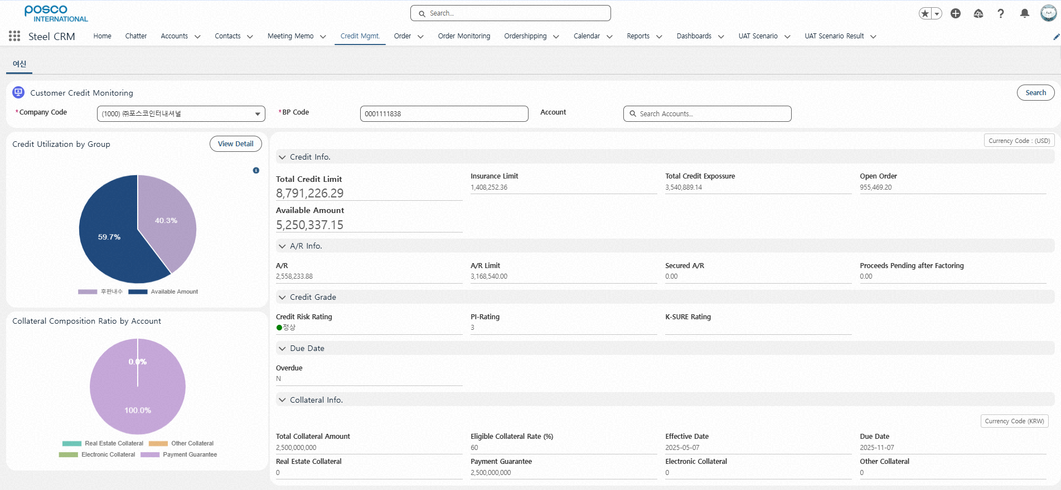
Step 1. Credit Management
Step (Lv.2) | Credit Information Overview | Step (Lv.3) | 1.1 Customer Credit Information Check (1/2)
Menu | Credit Management | User | All
Navigation | Credit Mgmt. > Credit Mgmt. Tab
1
Click the "Credit Management" menu
Click the [Search] button using the following criteria - Company code, BP code, Account Name
View credit usage status by group and collateral composition by customer (Pie Chart) - Credit usage and remaining limit ratio by group - On mouse hover: view amount (ratio, %)
View detailed information based on search criteria: - Total Credit Limit, Iusurance Limit, Open orders, …
※ Credit Currency: USD, Collateral Currency: KRW
2
3
4

Slide 5
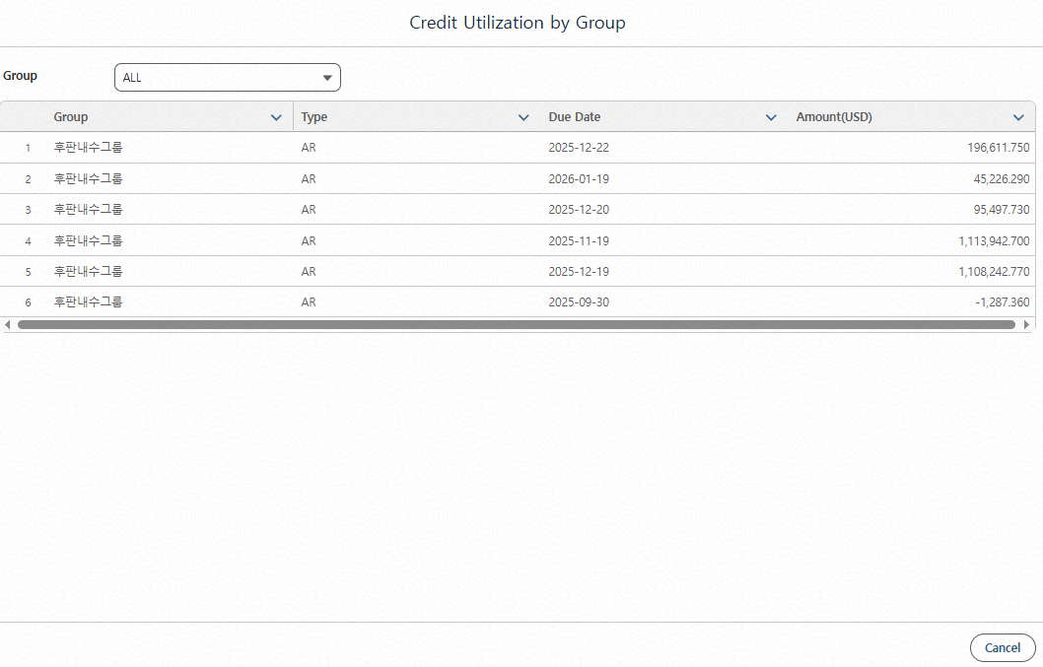
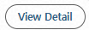

Step 1. Credit Management
Step (Lv.2) | Credit Information Overview | Step (Lv.3) | 1.1 Customer Credit Information Check (2/2)
Menu | Credit Management | User | All
Navigation | Credit Mgmt. > Credit Mgmt. Tab > View Detail button
Click the [View Detail] button in the Group-Level Credit Usage section. ※ Detailed view is only available when the user's company code matches.
View detailed credit usage amounts based on credit group, type, and due date - Filter by Group - Type: A/R, Nego(Factoring), Open billing ※ Prepayments and LC are not included in the Group-Level Credit Usage section.
5
6

Slide 6
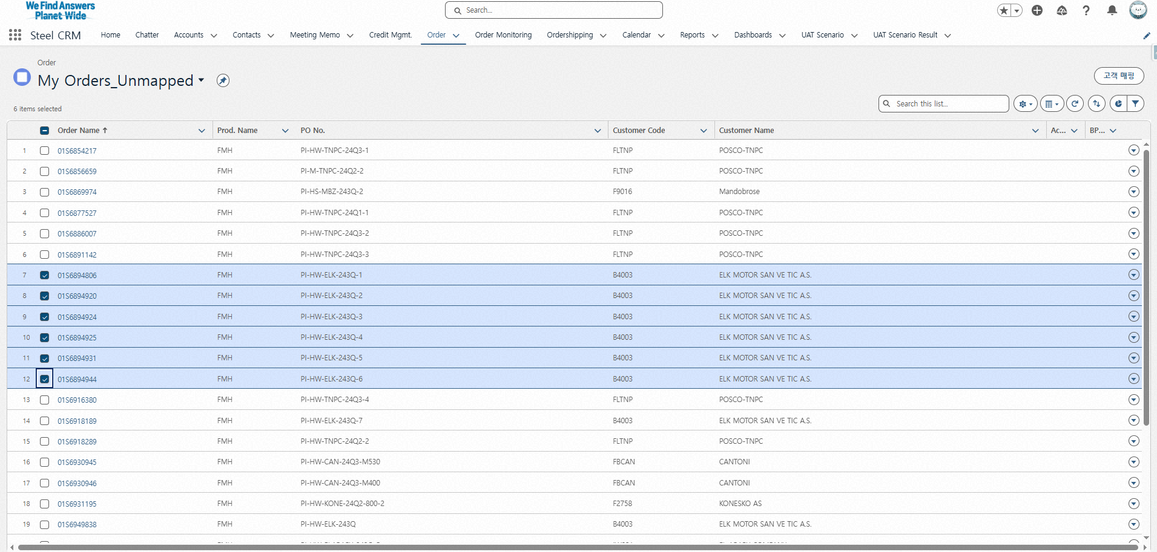
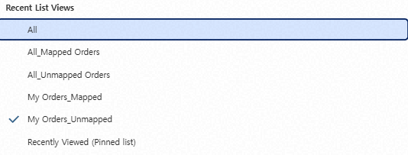
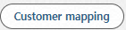
Step 2. Order Management
Step (Lv.2) | 1. POSCO Customer Mapping | Step (Lv.3) | 1.1 POSCO End-Customer Mapping (1/4)
Menu | Steel Orders | User | Steel Sales Representative
Navigation | Steel Orders
1
Click the "Steel Orders" menu - Access POSCO confirmed order Information
Filter confirmed orders using the following options - All, Mapped Orders, Ummapped Orders, My Order_Unmapped, My Order_Mapped, My Group_Unampped, My Group_Mapped
Select multiple Order Numbers for the same POSCO customer using checkboxes
Click the [Customer Mapping] button - Customer mapping is only available for confirmed order managers or users within the same group
※ "My Orders – Unmapped" will be displayed under [Home] > Unmapped Orders.
2
4
3

Slide 7
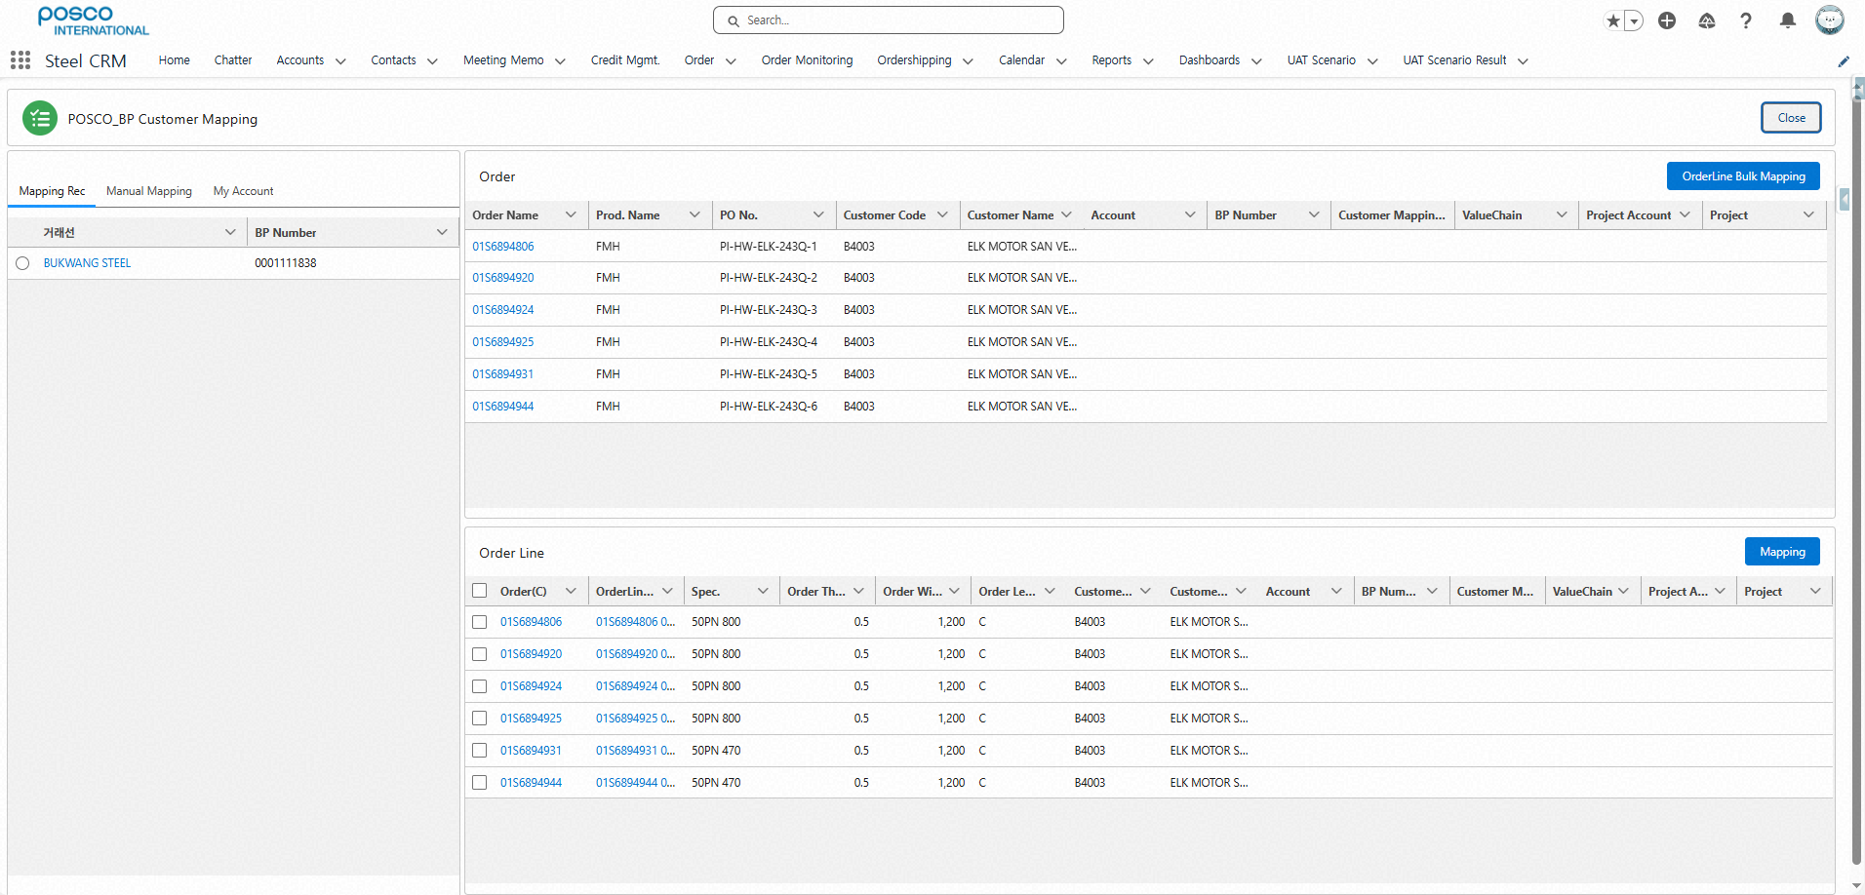
Step 2. Order Management
Step (Lv.2) | 1. POSCO Customer Mapping | Step (Lv.3) | 1.1 POSCO End-Customer Mapping (2/4)
Menu | Steel Orders | User | Steel Sales Representative
Navigation | Steel Orders > CRM Customer Mapping
Select Customer to Map for Each Confirmed Order - (Recommended Mapping): Customers with existing mapping history - ((Manual Mapping): Search and select customer manually - (My Customers): Customers marked as favorites (★) in the CRM "Customer" detail page
View list of selected Order Numbers
Click the [OrderLine Mapping] button → Opens the POSCO Customer Mapping Details popup window
5
6
7

Slide 8
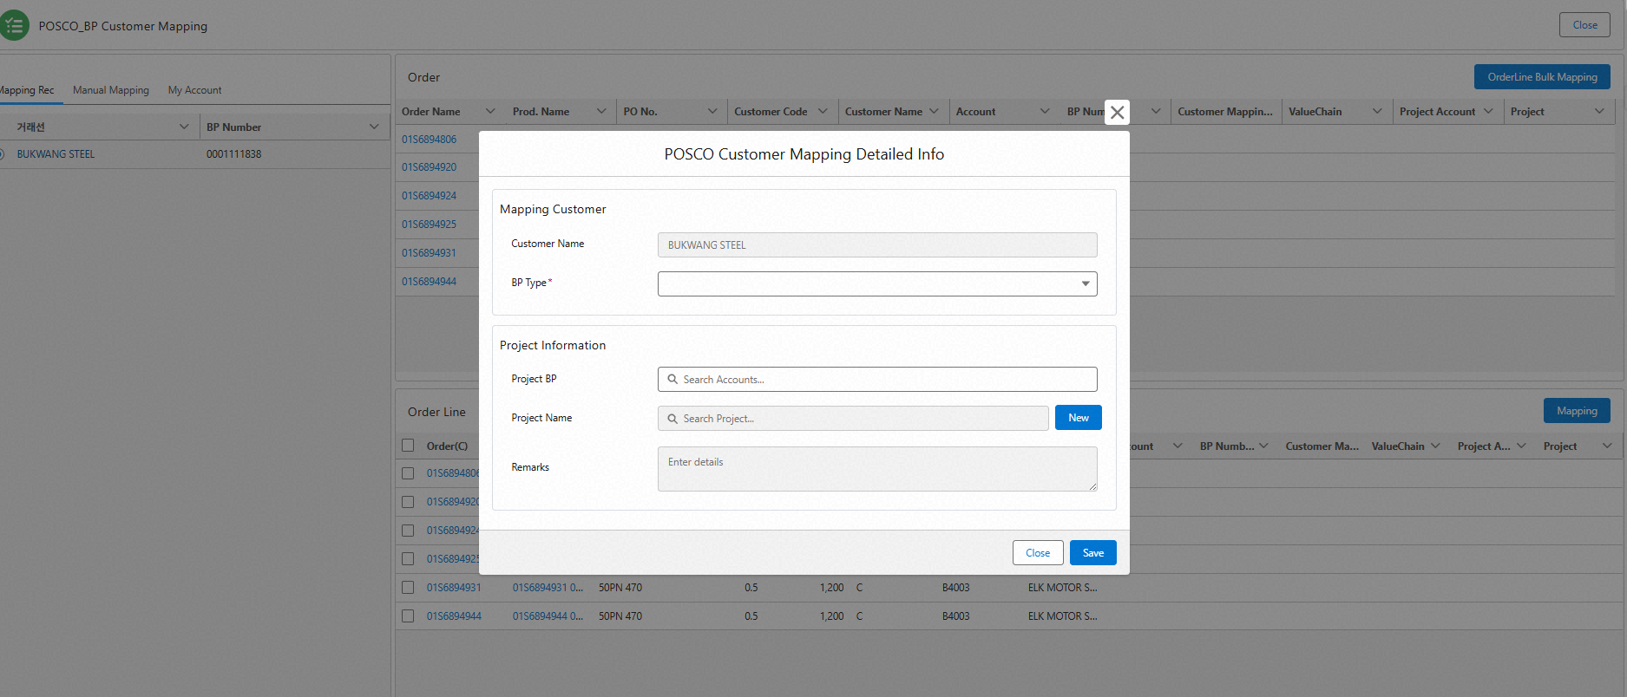
Step 2. Order Management
Step (Lv.2) | 1. POSCO Customer Mapping | Step (Lv.3) | 1.1 POSCO End-Customer Mapping (3/4)
Menu | Steel Orders | User | Steel Sales Representative
Navigation | Steel Orders > CRM Customer Mapping button > OrderLine Mapping button
Enter POSCO Customer Mapping Details - Customer Type selection is mandatory - Project Customer, Project Name, Remarks
Customer Type (Required) - Customer Type: Developer, Manufacturer, EPC, OEM, Distributor, Part Supplier, Turbin Supplier
When entering project information, link to the "Project Customer" under Contract/Project tab - If the selected Project Customer has existing projects, choose from the Project Name list - If no existing projects are found, click the [New] button, enter Project Name and Remarks, then click [Save] ※ Project will be linked under the Contract/Project tab of the Project Customer
8
9
10

Slide 9
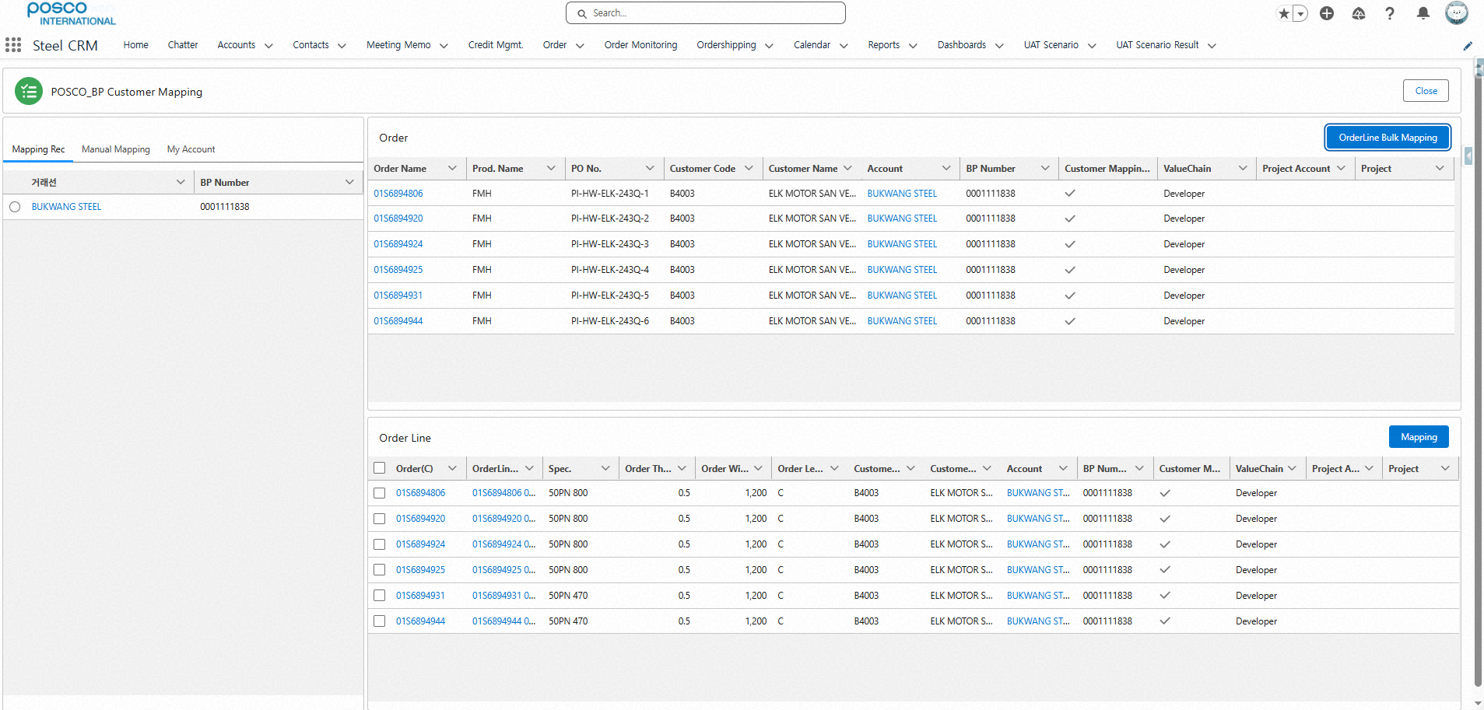
Step 2. Order Management
Step (Lv.2) | 1. POSCO Customer Mapping | Step (Lv.3) | 1.1 POSCO End-Customer Mapping (4/4)
Menu | Steel Orders | User | Steel Sales Representative
Navigation | Steel Orders > CRM Customer Mapping button > OrderLine Mapping button
Upon Completion of POSCO Customer Mapping - Mapping results are saved in: Account, BP Number, Mapping Status
After Order Number Mapping - To modify BP mapping per Order Line: . Select checkboxes for each line . Click the [Mapping] button to apply changes - When Order Number is mapped, all associated Order Lines are mapped together - When modifying mapping per Order Line, the parent Order Number remains unchanged
※ Once POSCO customer mapping for confirmed steel orders is completed, customer detail view and integrated order monitoring become available. → Therefore, this step is mandatory.
11
12

Slide 10
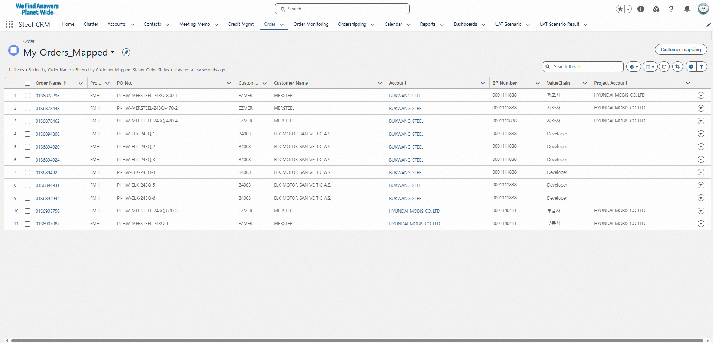
Step 2. Order Management
Step (Lv.2) | 2. POSCO Confirmed Order List | Step (Lv.3) | 2.1 POSCO Sales Order List (1/3)
Menu | Order | User | Steel Sales Representative
Navigation | Order
1
Click the "Order" Menu - Access My POSCO confirmed orders for registration/inquiry
Click the target Order Number to view details
2

Slide 11
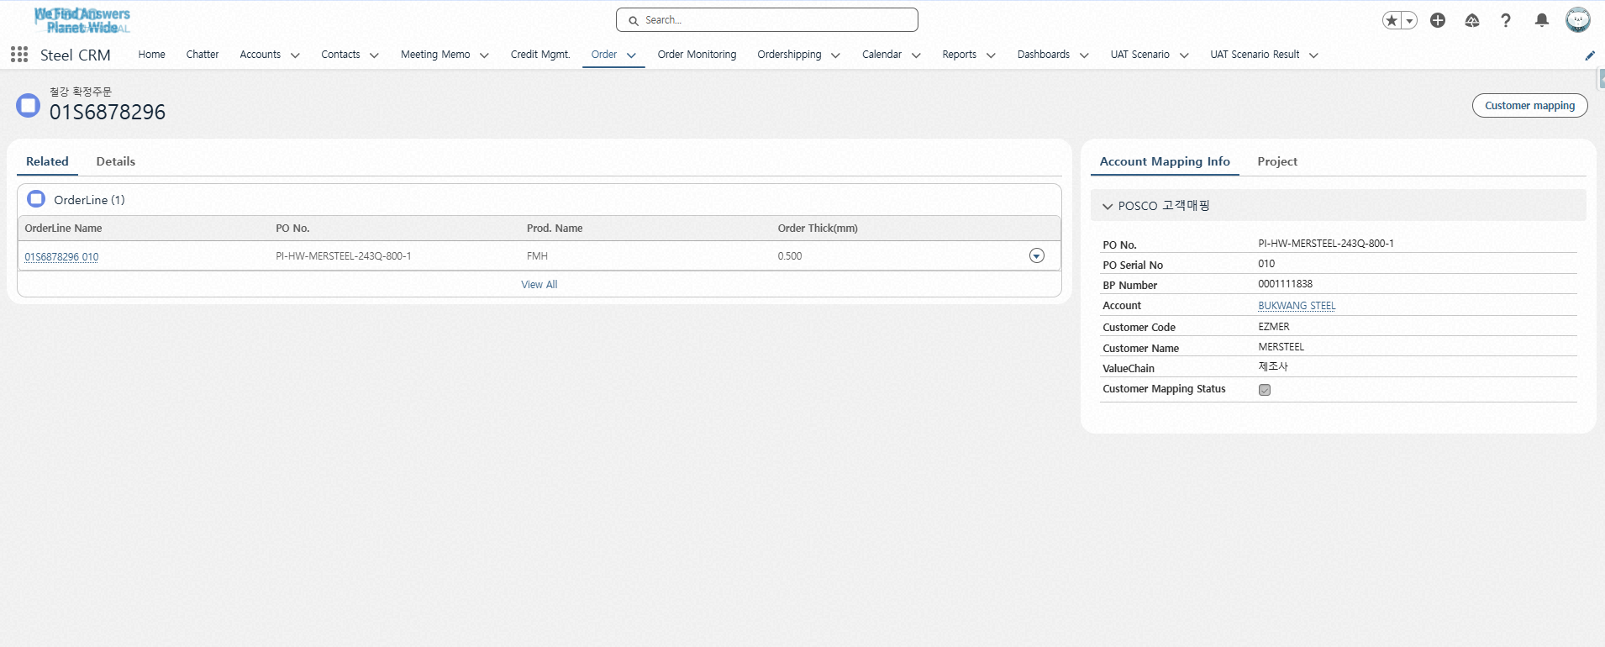
Step 2. Order Management
Step (Lv.2) | 2. POSCO Confirmed Order List | Step (Lv.3) | 2.1 POSCO Sales Order List (2/3)
Menu | Order | User | Steel Sales Representative
Navigation | Order
View Order Line List and Details from Selected Order Number Screen - Click the [Customer Mapping] button to switch to the POSCO–BP Customer Mapping screen
View POSCO Customer Mapping Information for the Selected Order Number - PO Number, BP Number, Account, …
3
4

Slide 12
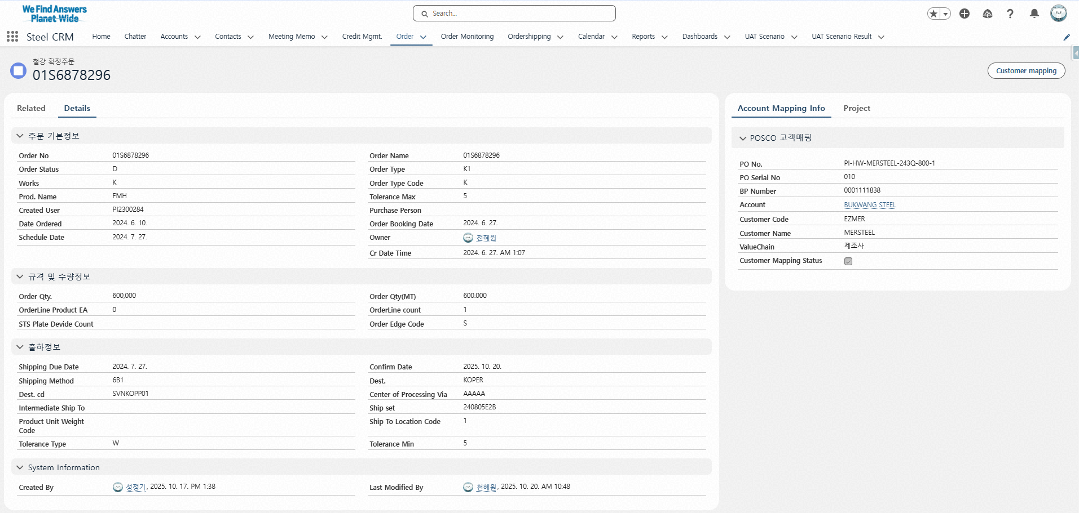
Step 2. Order Management
Step (Lv.2) | 2. POSCO Confirmed Order List | Step (Lv.3) | 2.1 POSCO Sales Order List (3/3)
Menu | Order | User | Steel Sales Representative
Navigation | Order
Click the [Details] Tab to View Order Details
Order Basic Information List - Oder no, Order Line no, Product code, Order Qty, …
Delivery/Shipment Information List - Destination, Confirm date, ..
5
6
7

Slide 13
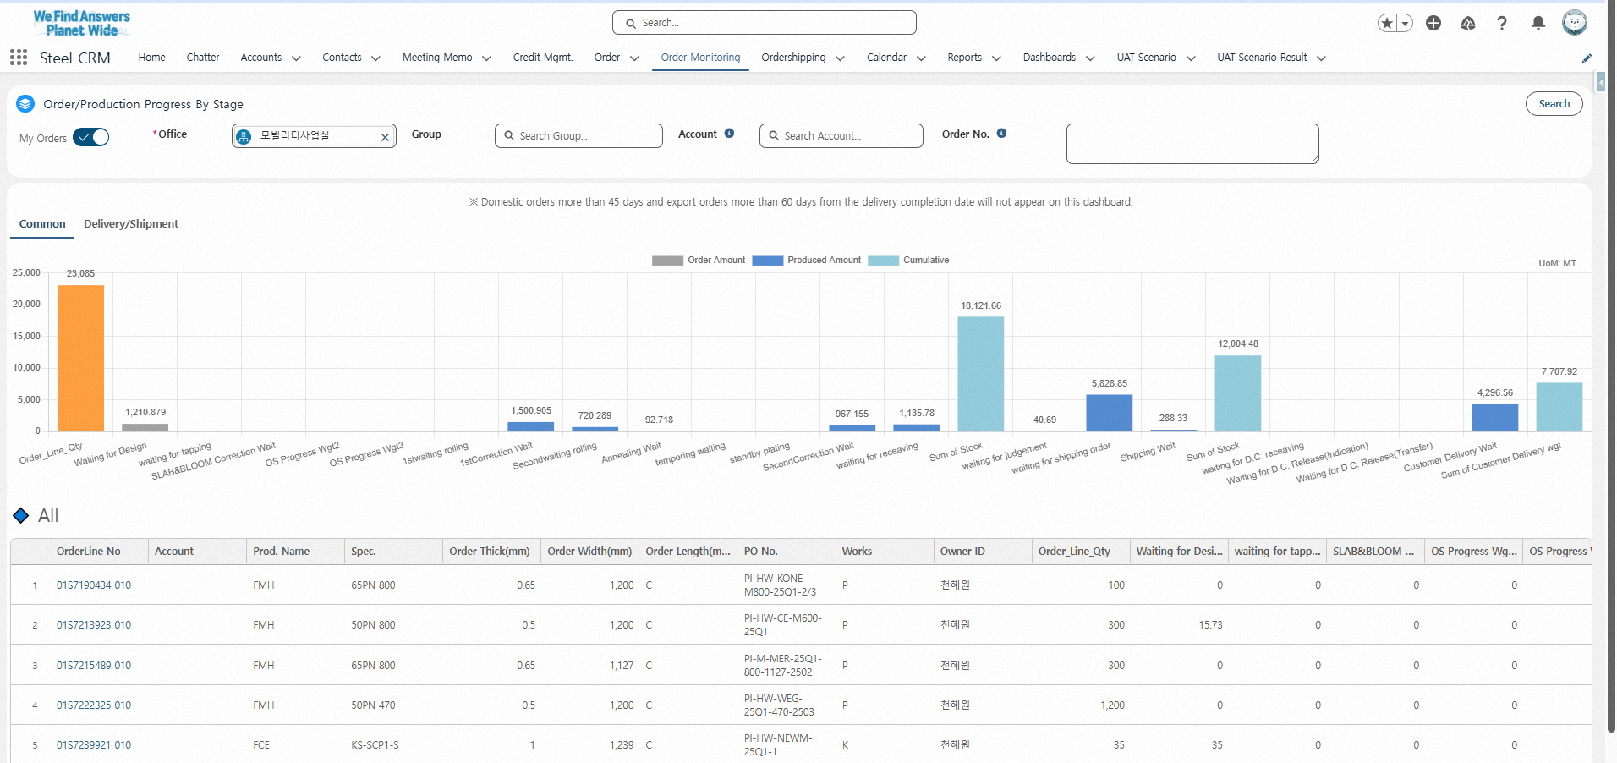
Step 2. Order Management
Step (Lv.2) | 3. Sales Order Fulfillment Monitoring | Step (Lv.3) | 3.1 Order/Production Status Tracking (1/2)
Menu | Order Monitoring | User | Steel Sales Representative
Navigation | Order Monitoring > Common Tab
1
Click the "Order Monitoring" Menu
Click the [Search] button using the following criteria - My Orders (default)
View Bar Chart Based on Search Criteria - Click on a bar to filter and view the corresponding order/production information list ※ Steel order/production quantities are displayed in M/T
View Detailed Order/Production Information by Order Line
※ Orders will not be displayed on this screen if more than 45 days (domestic) or 60 days (export) have passed since the Delivery Completion Date
2
3
4

Slide 14
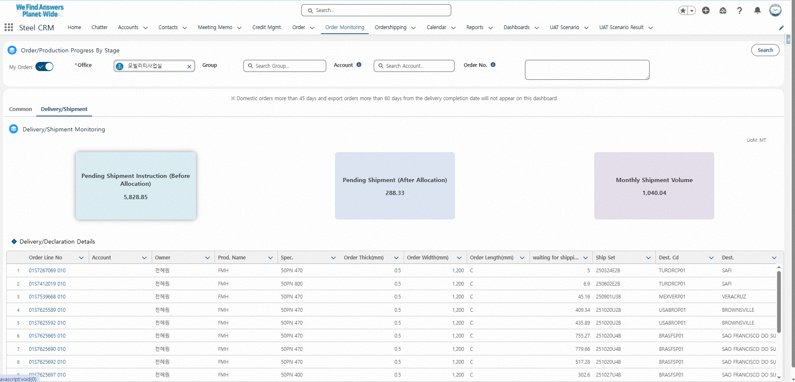
Step 2. Order Management
Step (Lv.2) | 3. Sales Order Fulfillment Monitoring | Step (Lv.3) | 3.1 Order/Production Status Tracking (2/2)
Menu | Order Monitoring | User | Steel Sales Representative
Navigation | Order Monitoring > Delivery/Shipment Tab
1
Click the "Order Monitoring" Menu
Click Delivery/Shipment tab
Click the [Search] button using the following criteria - My Orders (default)
View Shipment Status Based on Search Criteria - Pending Shipment Instruction - Ready for Shipment - Monthly Shipment Totals (Click the Scorecard to filter and view the corresponding shipment list) ※ Steel shipment quantities are displayed in M/T
View Detailed Shipment Information by Order Line - OrderLine No, Account, …
※ Both domestic and export shipment data are available for inquiry, but only export shipments are reflected in the Scorecard.
3
2
4
5

Slide 15
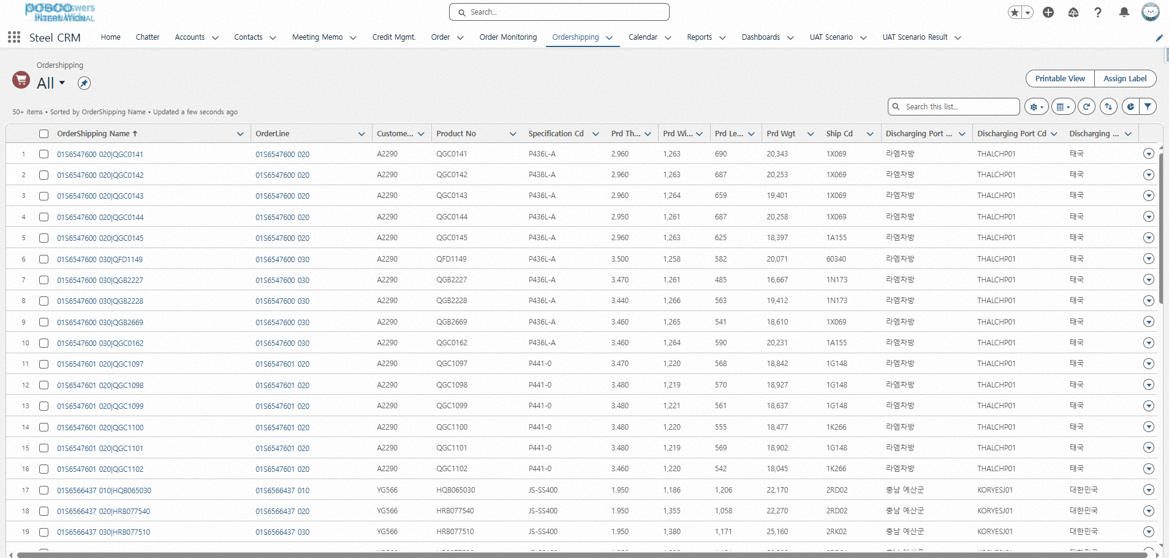
Step 2. Order Management
Step (Lv.2) | 4. Delivery & Shipment Status Monitoring | Step (Lv.3) | 4.1 Delivery&Shipment Status Monitoring (1/2)
Menu | Order Shipping | User | Steel Sales Representative
Navigation | Order Shipping
1
Click ‘Order Shipping’ Menu - View Shipping Information for My POSCO Steel Orders
Click the target Order Shipping item - Order Shipping is composed of: Order Line Number + Product Code
2

Slide 16
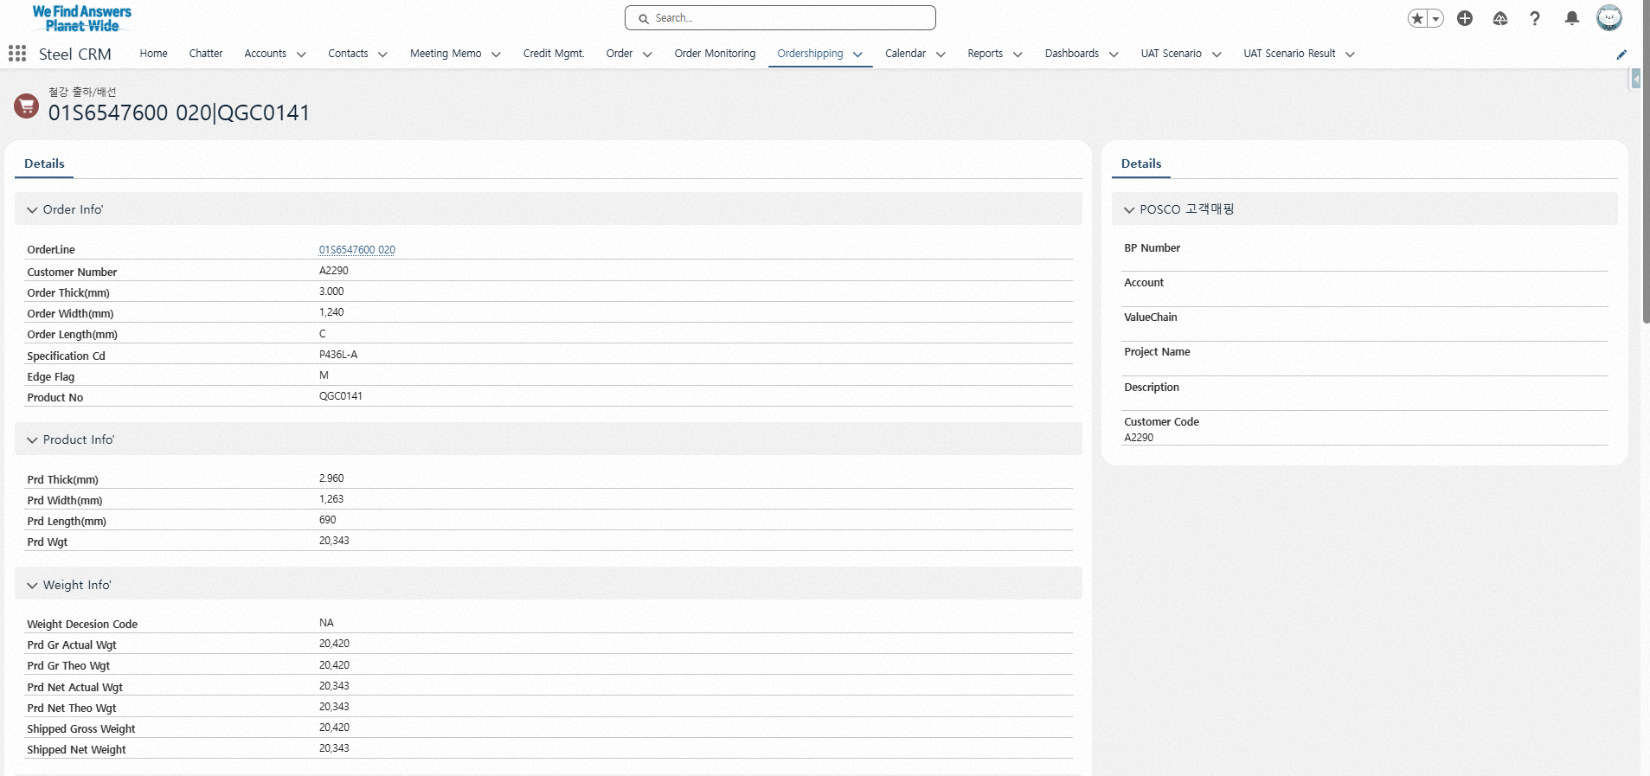
Step 2. Order Management
Step (Lv.2) | 4. Delivery & Shipment Status Monitoring | Step (Lv.3) | 4.1 Delivery&Shipment Status Monitoring (2/2)
Menu | Order Shipping | User | Steel Sales Representative
Navigation | Order Shipping
Order and Product Information List - Order Line no, Account name, Product no., Thickness, Length, …
Product Specification and Shipment Information List
POSCO Customer Mapping Information - BP code, Customer Name, Customer Type, Remark, …
3
5
4

Slide 17
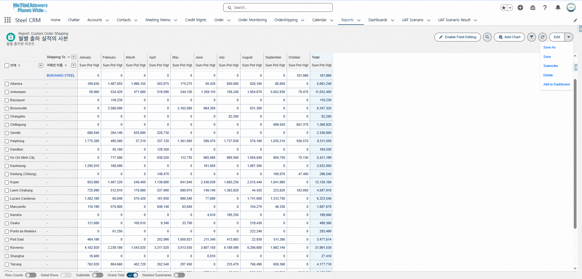

Step 3. Reporting & Performance
Step (Lv.2) | 1. Delivery Performance Report | Step (Lv.3) | 1.1 Monthly Delivery Performance Report (1/2)
Menu | Report | User | Steel Sales Representative
Navigation | Report > Monthly Delivery Performance Report
1
Click the "Report" Menu - Select the "Monthly Shipment Performance" report
View Total Product Weight (kg) and Monthly Shipment Summary Table - Default view shows shipment totals from January to December 2025
Click to Save As or Edit Report Fields - Save As: Copy & Paste (Personalized) - Subscribe: Add to Favorites - Add to Dashboard: Include in the "Dashboard" menu
2
3
Monthly Delivery Performance Report

Slide 18
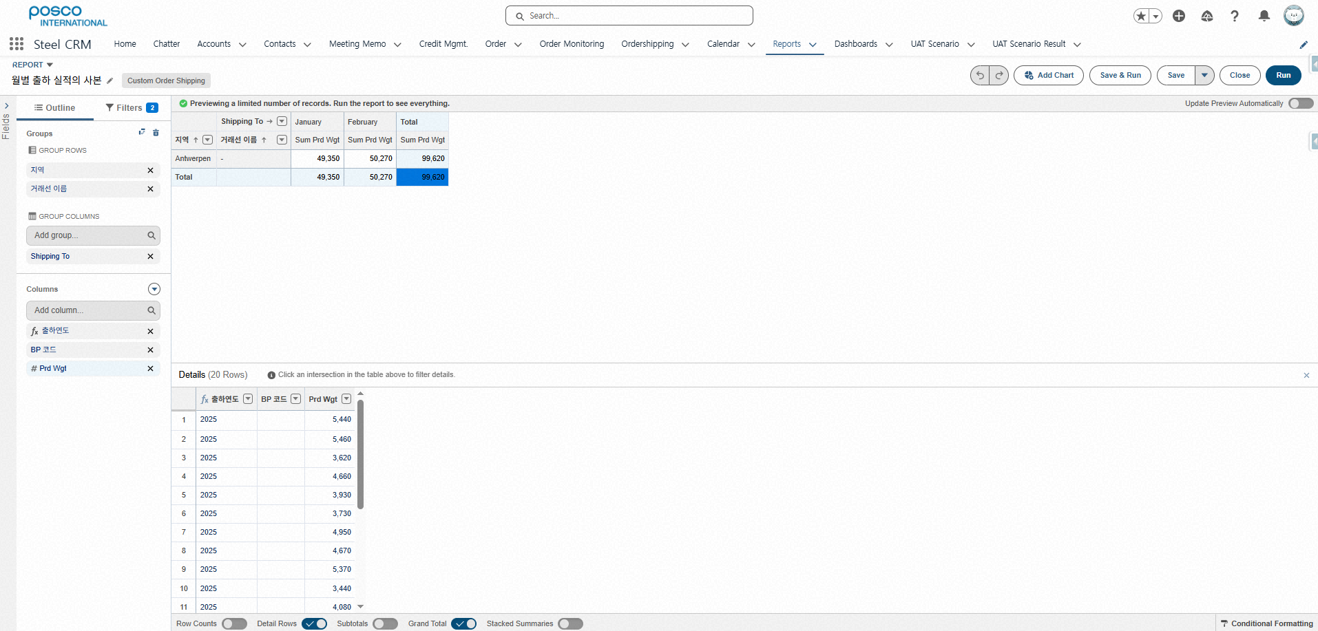
Step 3. Reporting & Performance
Step (Lv.2) | 1. Delivery Performance Report | Step (Lv.3) | 1.1 Monthly Delivery Performance Report (2/2)
Menu | Report | User | Steel Sales Representative
Navigation | Report > Monthly Delivery Performance Report
Report Field Editing Screen - Fields are structured in a pivot-like layout ※ Fields can be edited after using "Save As"
Monthly Shipment Performance Report Layout - Click the [Execute] button to apply changes ※ Excel download for shipment reports will be available in the second release (December)
6
4
5

Slide 19
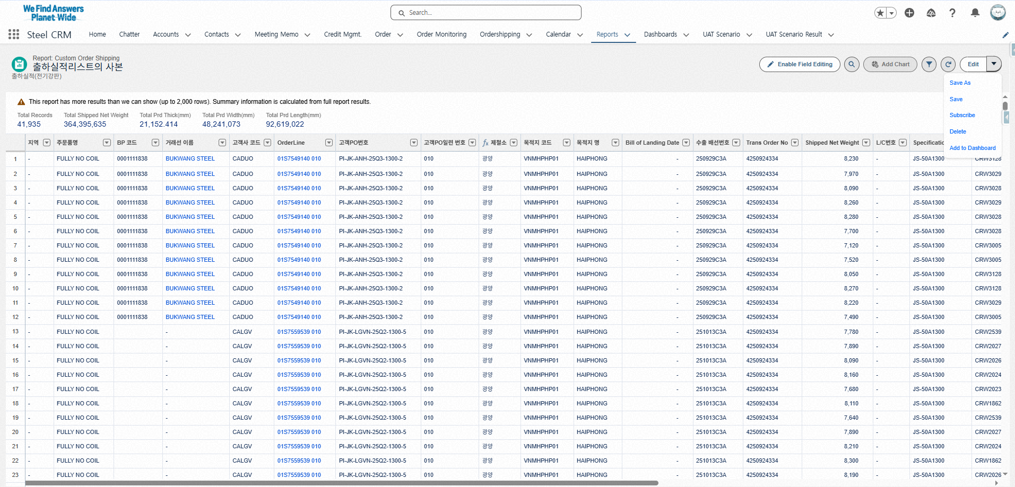
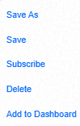
Step 3. Reporting & Performance
Step (Lv.2) | 1. Delivery Performance Report | Step (Lv.3) | 1.2 Delivery Performance Report (1/2)
Menu | Report | User | Steel Sales Representative
Navigation | Report > Delivery Performance Report
1
Click the "Report” Menu - Select the "Shipment Performance List" report
View Detailed Shipment List by Order Line Based on Customer/Representative
// Click to Save As or click the [Edit] button to open the report field configuration screen - Save As: Copy & Paste (Personalized) - Subscribe: Add to Favorites - Add to Dashboard: Include in the "Dashboard" menu
3
Delivery Performance Report
2

Slide 20
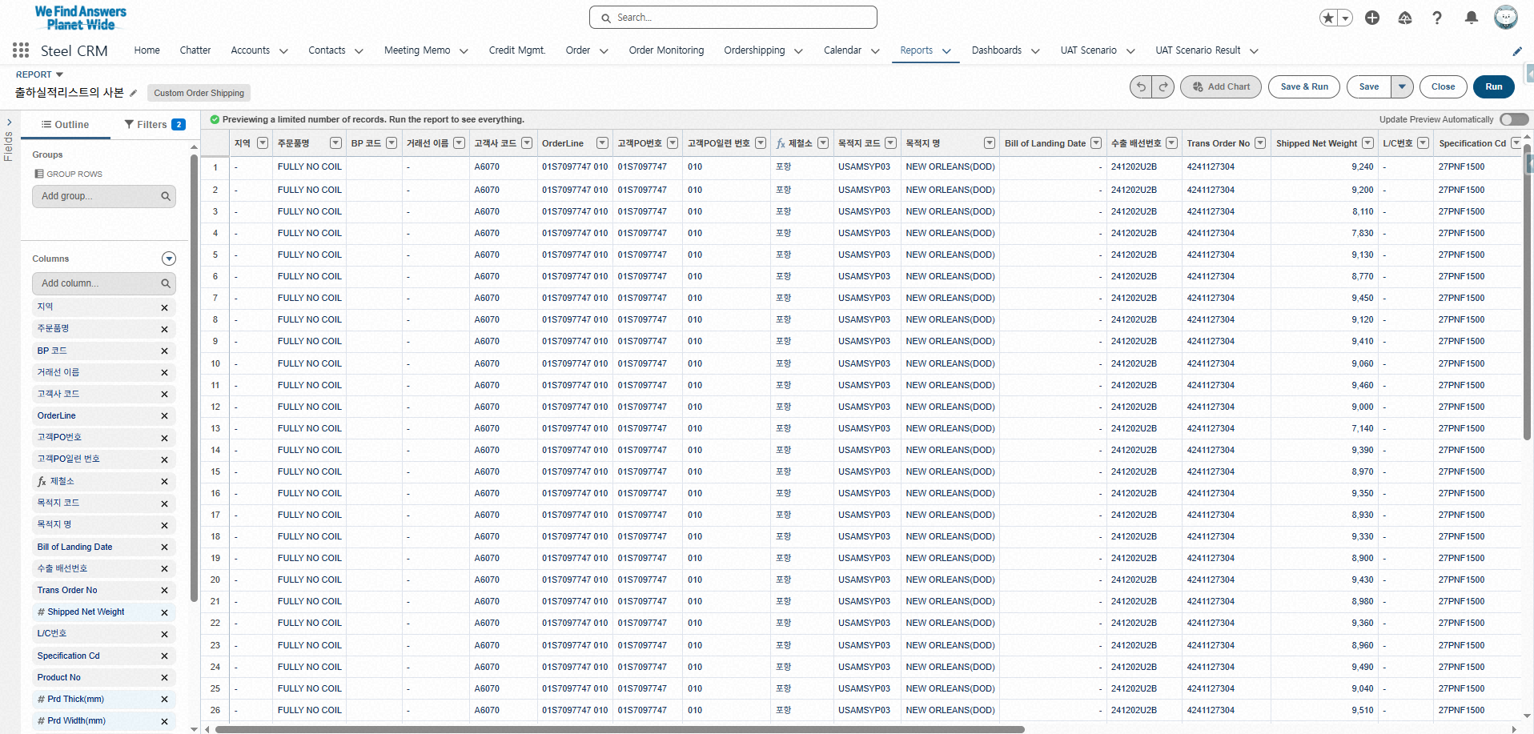
Step 3. Reporting & Performance
Step (Lv.2) | 1. Delivery Performance Report | Step (Lv.3) | 1.2 Delivery Performance Report (2/2)
Menu | Report | User | Steel Sales Representative
Navigation | Report > Delivery Performance Report
Report Field Editing Screen - Fields are structured in a pivot-like layout ※ Fields can be edited after using "Save As"
Monthly Shipment Performance Report Layout - Click the [Execute] button to apply changes ※ Excel download for shipment reports will be available in the second release (December)
6
4
5

Slide 21
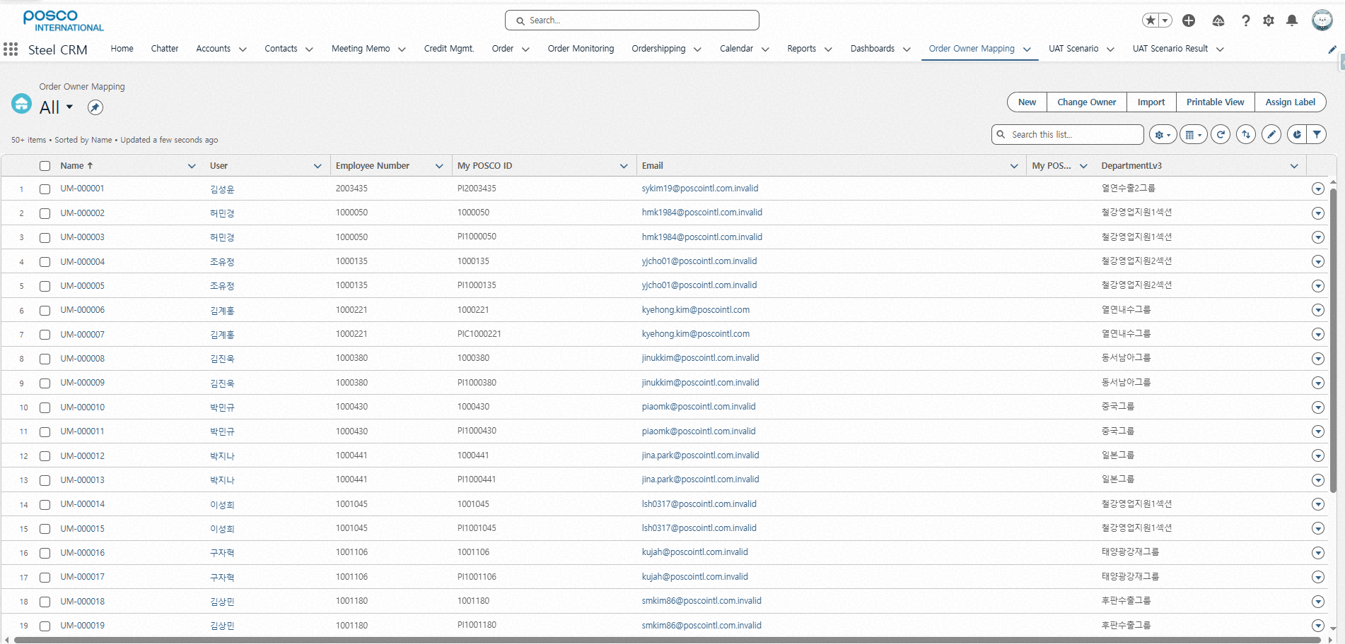
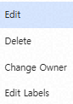
Step 4. User Role Assignment for Sale Order Mgmt.
Step (Lv.2) | 1. POSCO Manager Identification Control | Step (Lv.3) | 1.1 Order Owner Mapping
Menu | Order Owner Mapping | User | CRM System Admin
Navigation | Order Owner Mapping
1
Click ‘Order Owner Mapping’ Menu - Displays the screen for mapping My POSCO user accounts with CRM user information
Manage My POSCO Accounts by CRM User
Click to Edit / Delete / Change Owner
※ This menu is accessible only to CRM system users
2
3

Slide 22
Contents_Mobile
Step 1
Credit Management
Credit Information Overview 1.1 Customer Credit Information Check
Step 2
Order Management
POSCO Customer Mapping 1.1 POSCO End-Customer Mapping
POSCO Confirmed Order List 2.1 POSCO Sales Order List
Sales Order Fulfillment Monitoring 3.1 Order/Production Status Tracking
Delivery & Shipment Status Monitoring 4.1 Delivery and Shipment Status Overview

Slide 23
Contents_Mobile
Step 3
Reporting & Performance
Delivery Performance Report 1.1 Monthly Delivery Performance Report 1.2 Delivery Performance Report
Step 4
User Role Assignment for Sales Order Mgmt.
POSCO Manager Identification Control 1.1 Order Owner Mapping

Slide 24
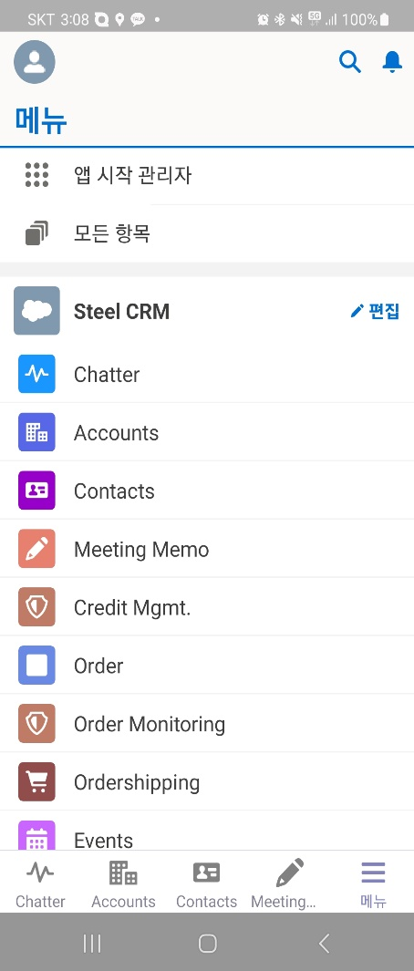
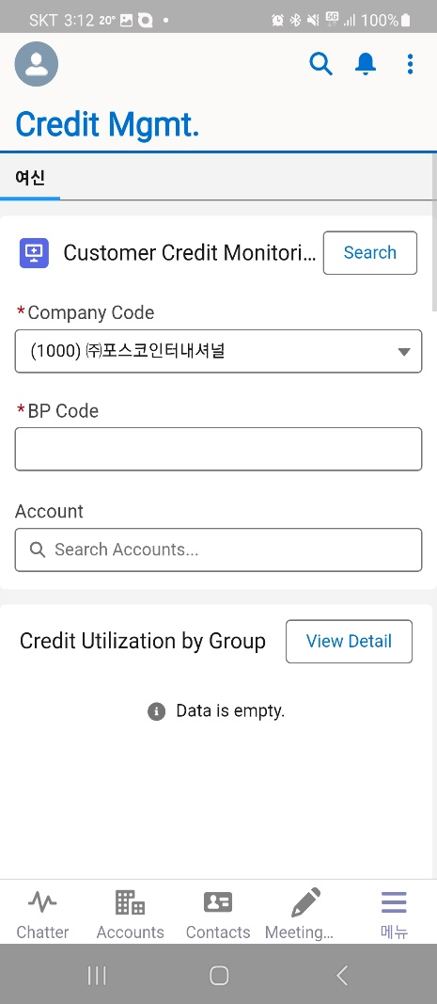
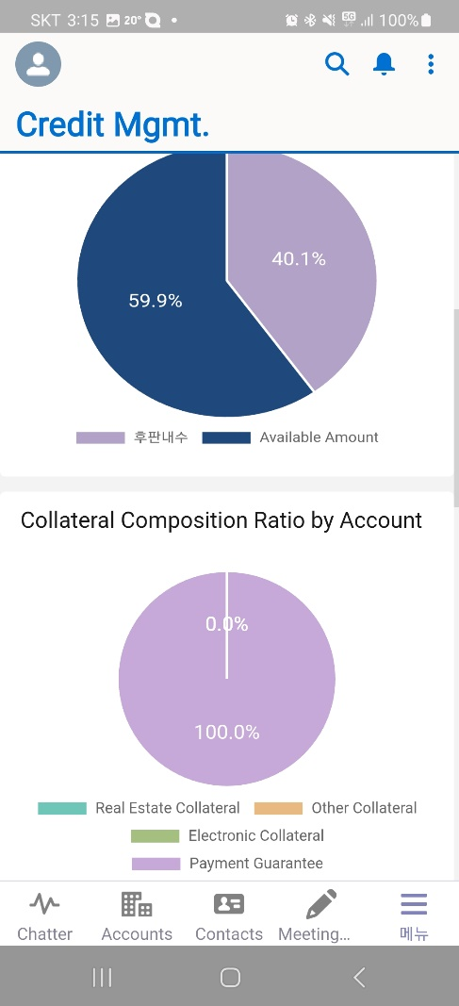
Step 1. Credit Management
Step (Lv.2) | Credit Information Overview | Step (Lv.3) | 1.1 Customer Credit Information Check (1/3)
Menu | Credit Management | User | All
Navigation | Credit Mgmt. > Credit Mgmt. Tab
Click the "Credit Management" menu
Click the [Search] button using the following criteria - Company code, BP code, Account Name
View credit usage status by group and collateral composition by customer (Pie Chart) - Credit usage and remaining limit ratio by group - On mouse hover: view amount (ratio, %)
※ Credit Currency: USD, Collateral Currency: KRW
Menu
1
Credit
3
2
Edit

Slide 25
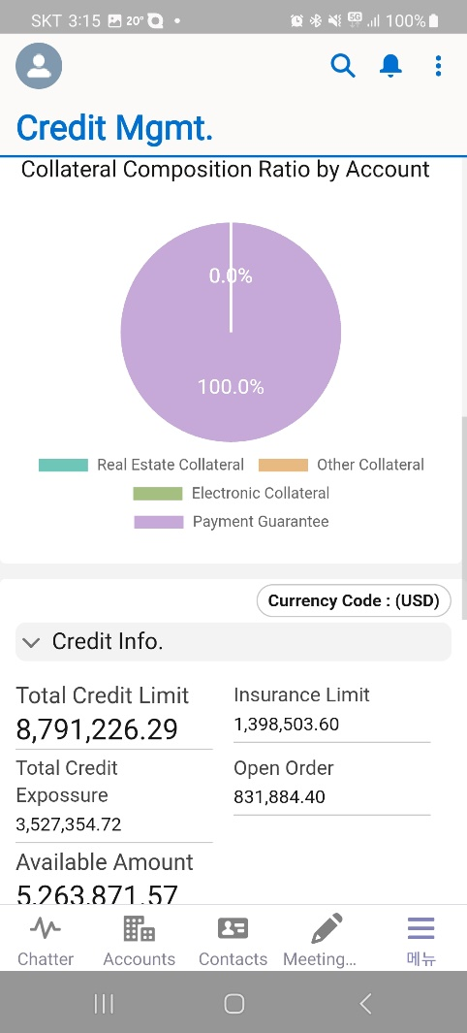
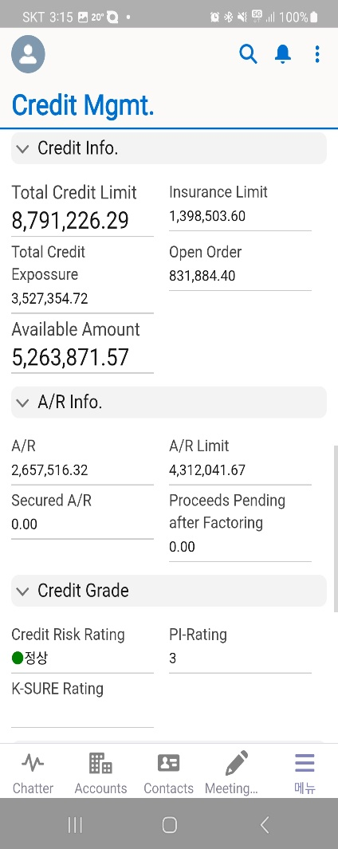
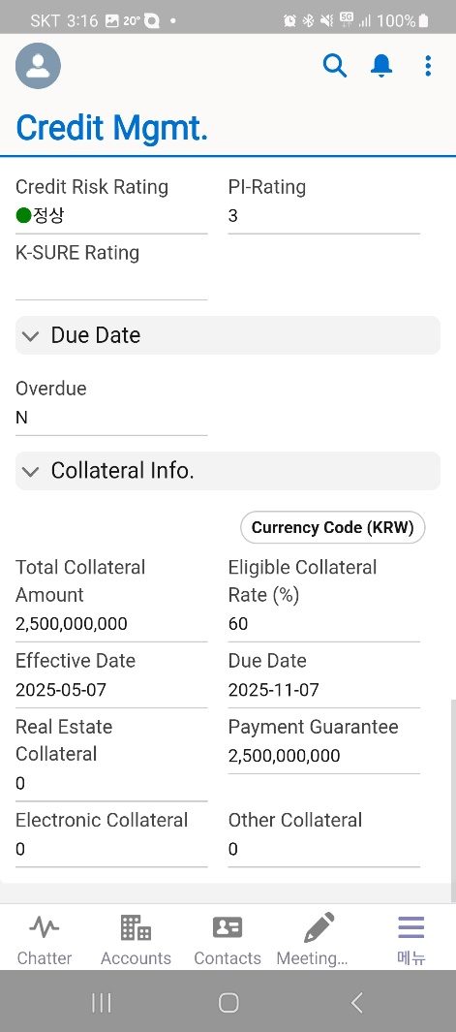
Step 1. Credit Management
Step (Lv.2) | Credit Information Overview | Step (Lv.3) | 1.1 Customer Credit Information Check (2/3)
Menu | Credit Management | User | All
Navigation | Credit Mgmt. > Credit Mgmt. Tab
View detailed information based on search criteria: - Total Credit Limit, Iusurance Limit, Open orders, …
※ Credit Currency: USD, Collateral Currency: KRW
4

Slide 26
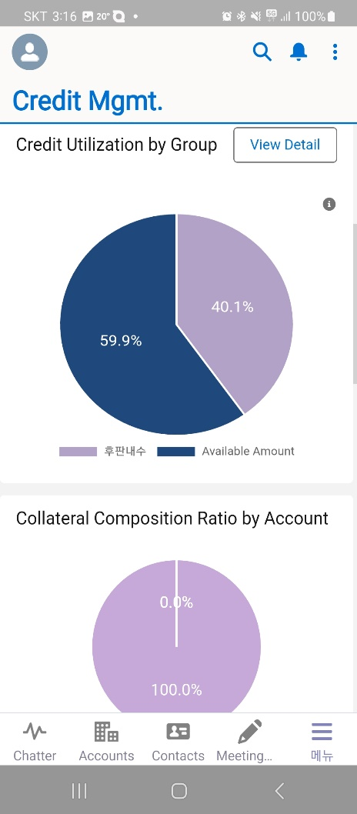
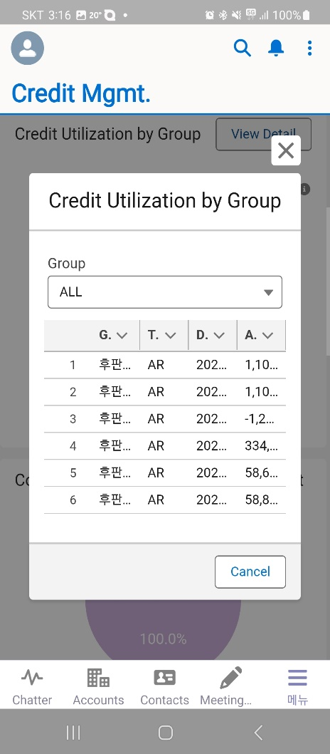
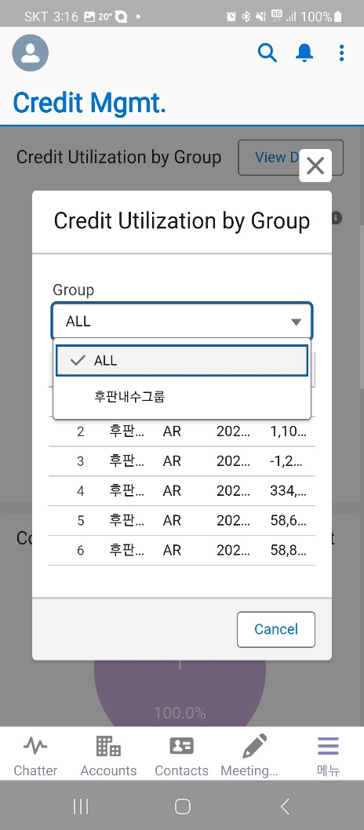
Step 1. Credit Management
Step (Lv.2) | Credit Information Overview | Step (Lv.3) | 1.1 Customer Credit Information Check (3/3)
Menu | Credit Management | User | All
Navigation | Credit Mgmt. > Credit Mgmt. Tab > View Detail button
Click the [View Detail] button in the Group-Level Credit Usage section. ※ Detailed view is only available when the user's company code matches.
View detailed credit usage amounts based on credit group, type, and due date - Filter by Group - Type: A/R, Nego(Factoring), Open billing ※ Prepayments and LC are not included in the Group-Level Credit Usage section.
5
6

Slide 27

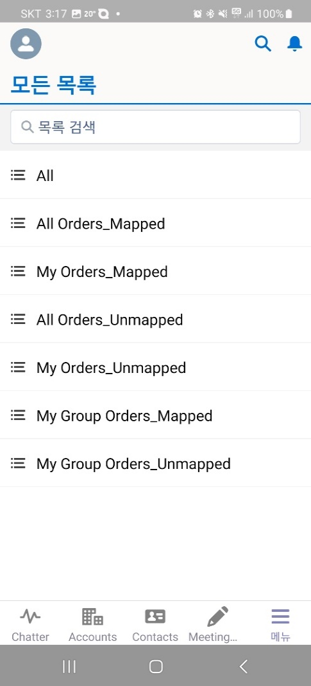
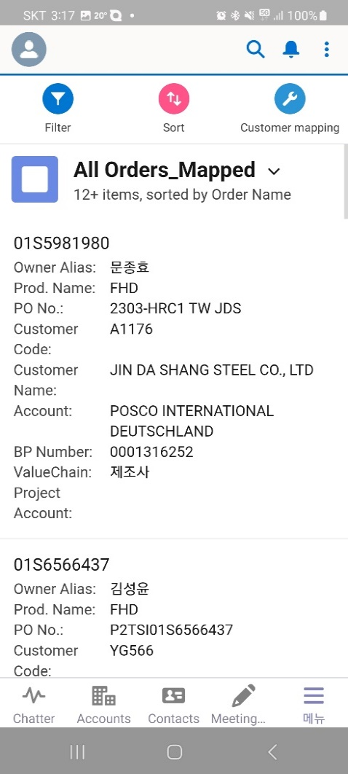
Step 2. Order Management
Step (Lv.2) | 1. POSCO Customer Mapping | Step (Lv.3) | 1.1 POSCO End-Customer Mapping (1/4)
Menu | Steel Orders | User | Steel Sales Representative
Navigation | Steel Orders
Click the "Steel Orders” menu - Access POSCO confirmed orders for registration/inquiry
Filter confirmed orders using the following options - All, Mapped Orders, Ummapped Orders, My Order_Unmapped, My Order_Mapped, My Group_Unampped, My Group_Mapped
Select Order No. for CRM Customer Mapping
※ "My Orders – Unmapped" will be displayed under [Home] > Unmapped Orders.
Menu
All
2
3
Edit
1
Steel Orders
Steel Order Monitoring
Steel Ordershipping

Slide 28
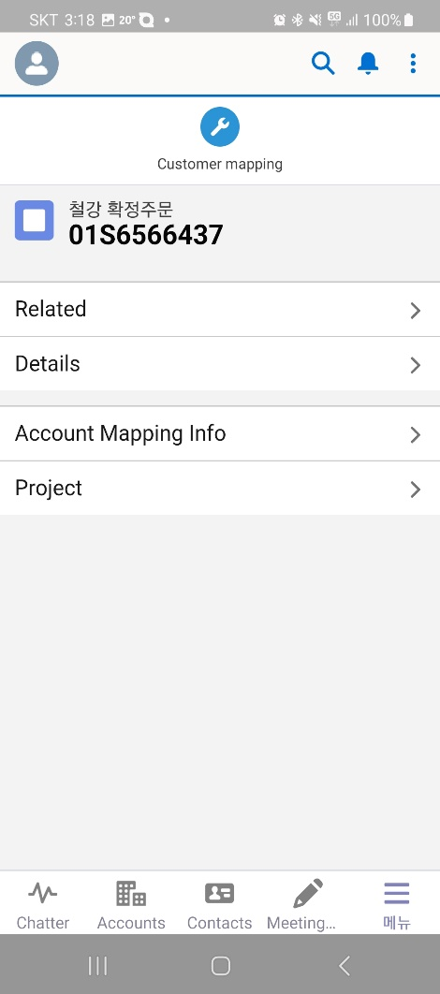
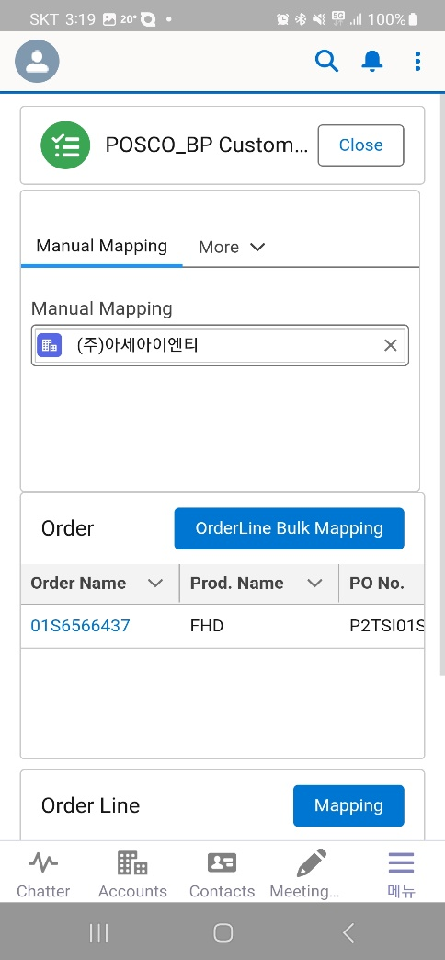
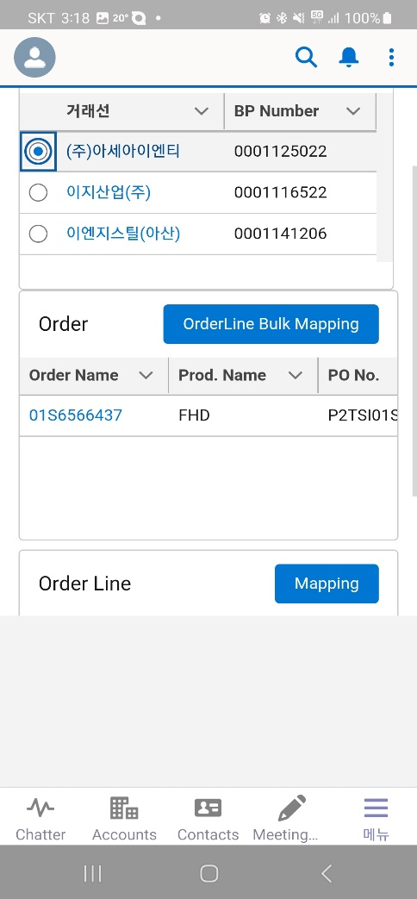
Step 2. Order Management
Step (Lv.2) | 1. POSCO Customer Mapping | Step (Lv.3) | 1.1 POSCO End-Customer Mapping (2/4)
Menu | Steel Orders | User | Steel Sales Representative
Navigation | Steel Orders > CRM Customer Mapping button
Click the [Customer Mapping] button - Customer mapping is only available for confirmed order managers or users within the same group
Search CRM Customer and Select - (Recommended Mapping): Customers with existing mapping history - ((Manual Mapping): Search and select customer manually - (My Customers): Customers marked as favorites (★) in the CRM "Customer" detail page
Click the [Customer Mapping] button - Customer mapping is only available for confirmed order managers or users within the same group
4
5
6
Scroll
Swipe
Swipe

Slide 29
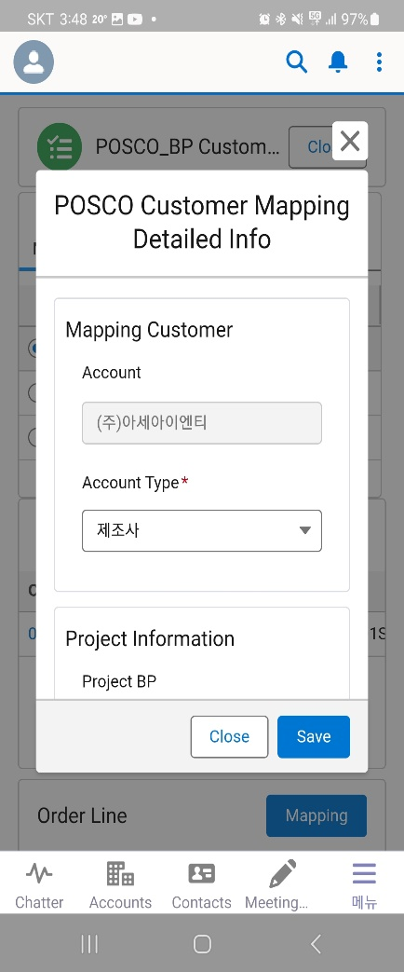
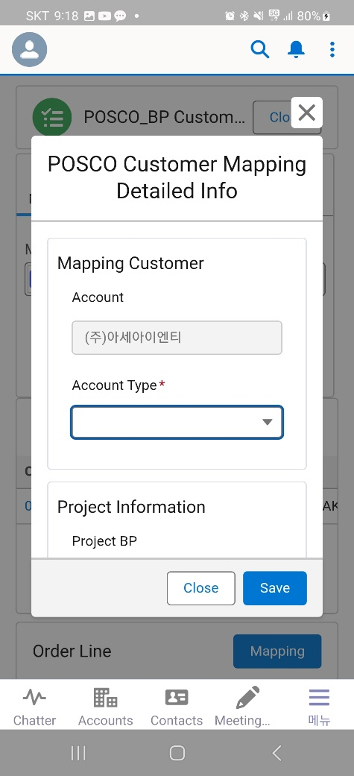
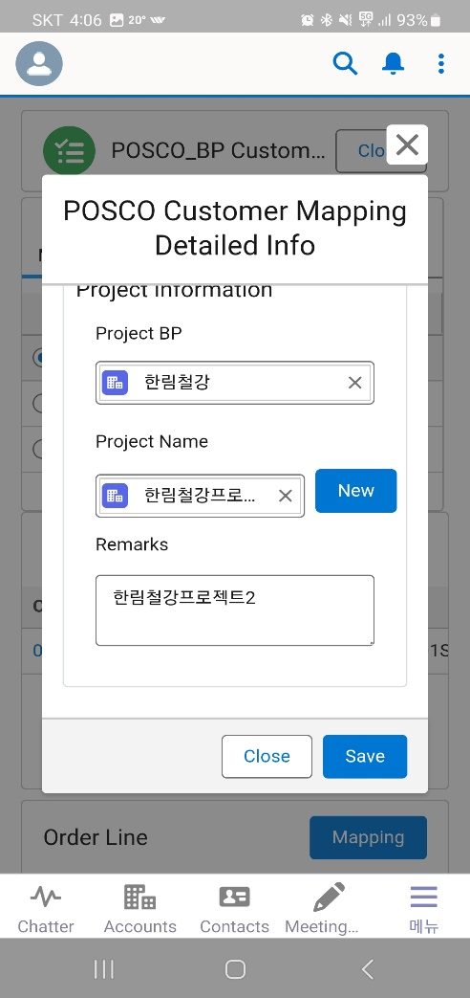
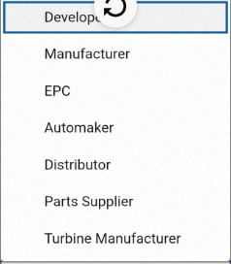
Step 2. Order Management
Step (Lv.2) | 1. POSCO Customer Mapping | Step (Lv.3) | 1.1 POSCO End-Customer Mapping (3/4)
Menu | Steel Orders | User | Steel Sales Representative
Navigation | Steel Orders > CRM Customer Mapping button > OrderLine Mapping button
Enter POSCO Customer Mapping Details - Customer Type selection is mandatory - Project Customer, Project Name, Remarks
Customer Type (Required) - Customer Type: Developer, Manufacturer, EPC, OEM, Distributor, Part Supplier, Turbin Supplier
When entering project information, link to the "Project Customer" under Contract/Project tab - If the selected Project Customer has existing projects, choose from the Project Name list - If no existing projects are found, click the [New] button, enter Project Name and Remarks, then click [Save] ※ Project will be linked under the Contract/Project tab of the Project Customer
9
7
8

Slide 30
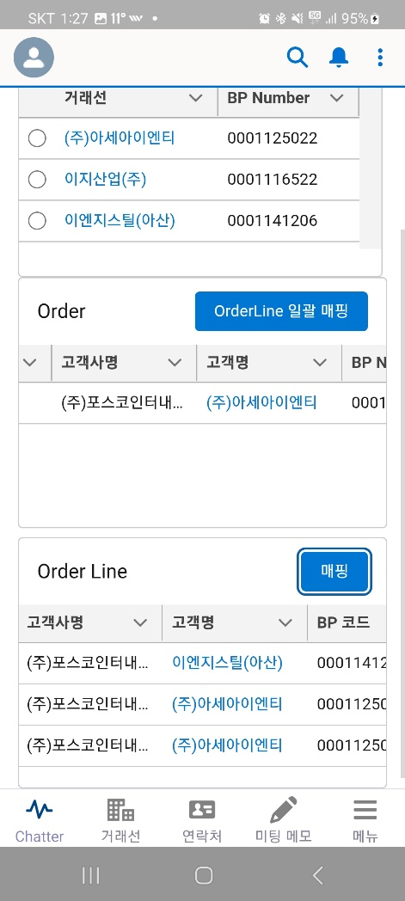
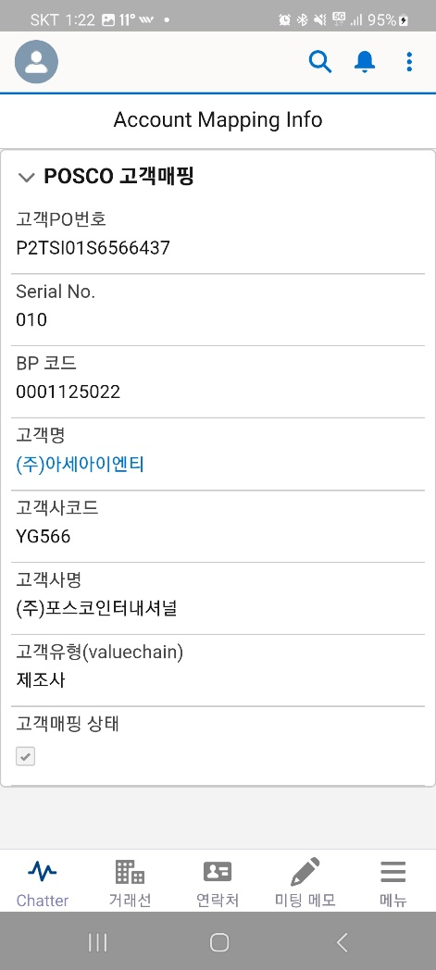
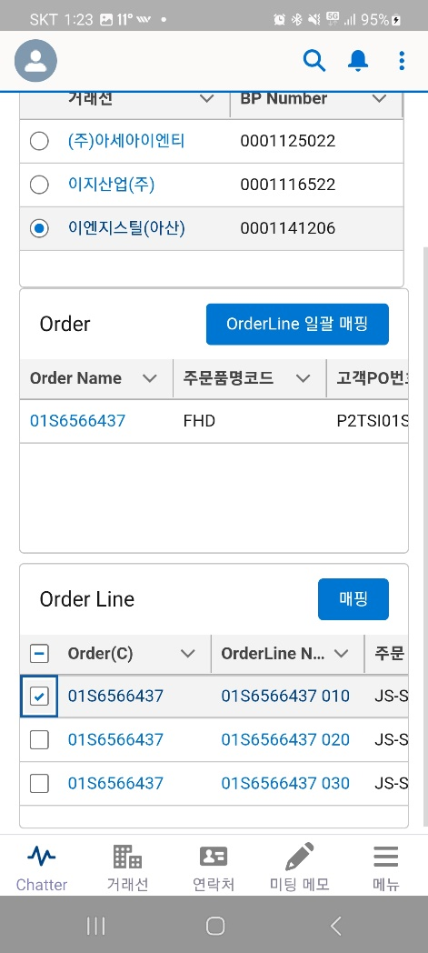
Step 2. Order Management
Step (Lv.2) | 1. POSCO Customer Mapping | Step (Lv.3) | 1.1 POSCO End-Customer Mapping (4/4)
Menu | Steel Orders | User | Steel Sales Representative
Navigation | Steel Orders > CRM Customer Mapping button > OrderLine Mapping button > [Save]
Upon Completion of POSCO Customer Mapping - Mapping results are saved in: Account, BP Number, Mapping Status
After Order Number Mapping - To modify BP mapping per Order Line: . Select checkboxes for each line . Click the [Mapping] button to apply changes - When Order Number is mapped, all associated Order Lines are mapped together - When modifying mapping per Order Line, the parent Order Number remains unchanged ※ Once POSCO customer mapping for confirmed steel orders is completed, customer detail view and integrated order monitoring become available. → Therefore, this step is mandatory.
10
OrderLine Bulk Mapping
OrderLine Bulk Mapping
11
Mapping
Mapping

Slide 31
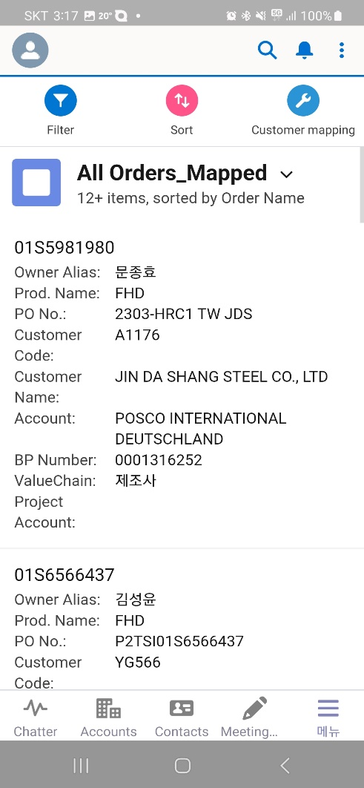
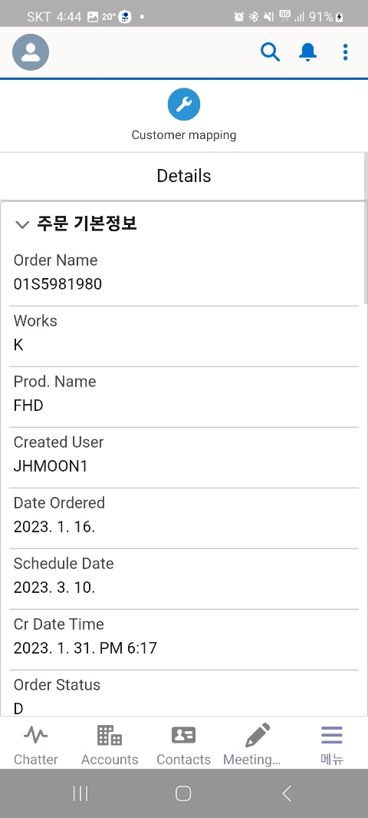
Step 2. Order Management
Step (Lv.2) | 2. POSCO Confirmed Order List | Step (Lv.3) | 2.1 POSCO Sales Order List (1/1)
Menu | Steel Orders | User | Steel Sales Representative
Navigation | Steel Orders
Click the “Steel Order" Menu - Access My POSCO confirmed orders for registration/inquiry
Click the target Order Number to view details
View Order Information
Menu
2
3
Order Info.
Edit
Scroll
1
Steel Orders
Steel Order Monitoring
Steel Ordershipping

Slide 32
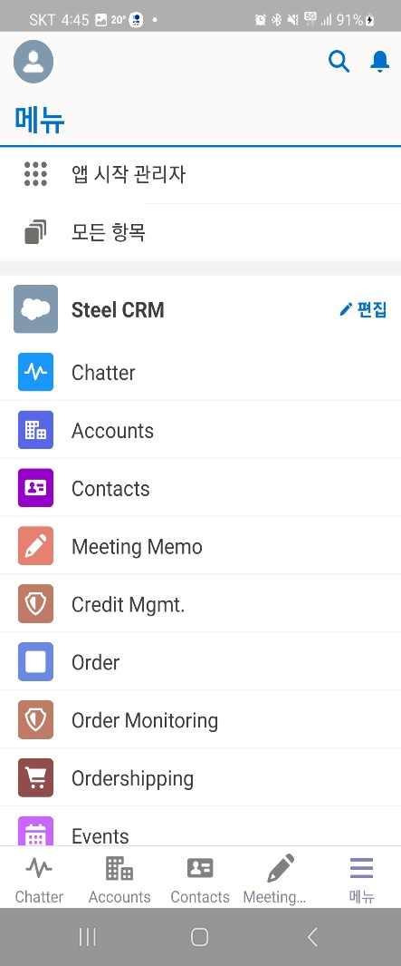
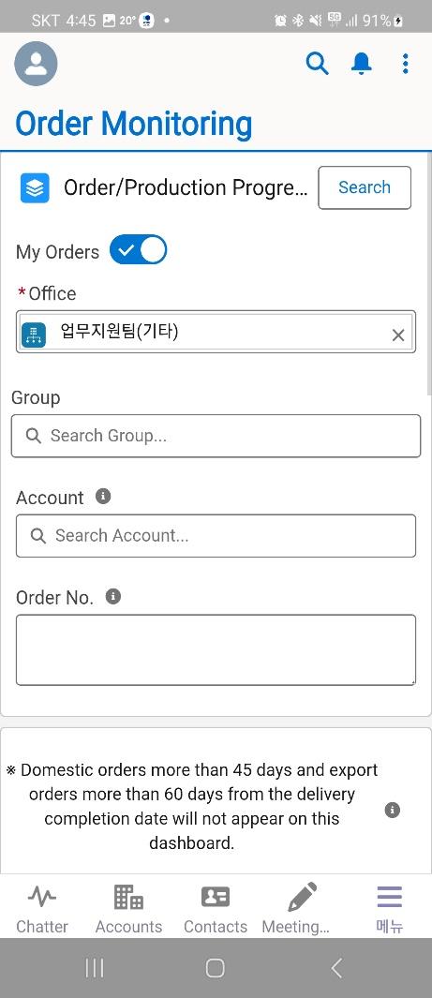
Step 2. Order Management
Step (Lv.2) | 3. Sales Order Fulfillment Monitoring | Step (Lv.3) | 3.1 Order/Production Status Tracking (1/3)
Menu | Steel Order Monitoring | User | Steel Sales Representative
Navigation | Steel Order Monitoring > Common Tab
Click the “Steel Order Monitoring” Menu
Click the [Search] button using the following criteria - My Orders (default)
Menu
2
Edit
1
Steel Orders
Steel Order Monitoring
Steel Ordershipping

Slide 33
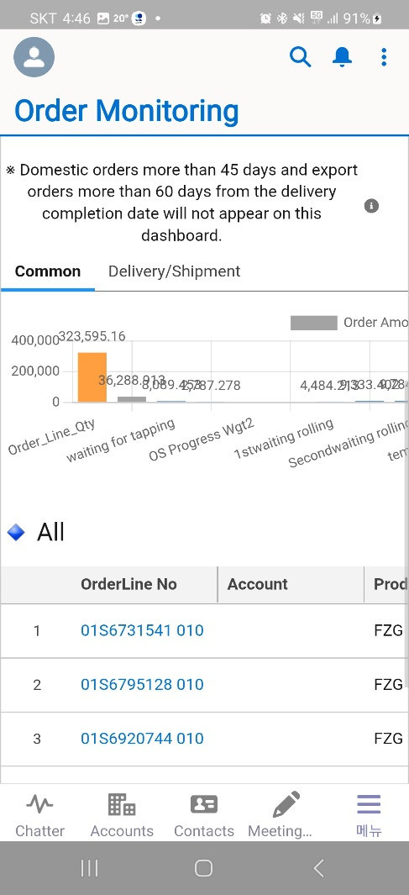
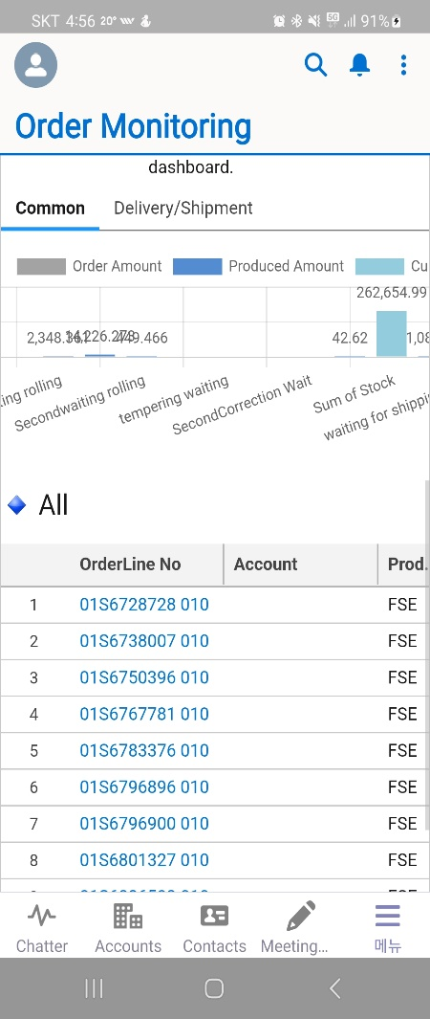

Step 2. Order Management
Step (Lv.2) | 3. Sales Order Fulfillment Monitoring | Step (Lv.3) | 3.1 Order/Production Status Tracking (2/3)
Menu | Steel Order Monitoring | User | Steel Sales Representative
Navigation | Steel Order Monitoring > Common Tab
View Bar Chart Based on Search Criteria - Click on a bar to filter and view the corresponding order/production information list ※ Steel order/production quantities are displayed in M/T
View Detailed Order/Production Information by Order Line ※ Orders will not be displayed on this screen if more than 45 days (domestic) or 60 days (export) have passed since the Delivery Completion Date
3
Swipe
Swipe
4

Slide 34


Step 2. Order Management
Step (Lv.2) | 3. Sales Order Fulfillment Monitoring | Step (Lv.3) | 3.1 Order/Production Status Tracking (3/3)
Menu | Order Monitoring | User | Steel Sales Representative
Navigation | Order Monitoring > Delivery/Shipment Tab
Click Delivery/Shipment tab
Click the [Search] button using the following criteria - My Orders (default)
View Shipment Status Based on Search Criteria - Pending Shipment Instruction - Ready for Shipment - Monthly Shipment Totals (Click the Scorecard to filter and view the corresponding shipment list) ※ Steel shipment quantities are displayed in M/T
View Detailed Shipment Information by Order Line - OrderLine No, Account, …
※ Both domestic and export shipment data are available for inquiry, but only export shipments are reflected in the Scorecard.
6
5
7
8
Swipe

Slide 35

Step 2. Order Management
Step (Lv.2) | 4. Delivery & Shipment Status Monitoring | Step (Lv.3) | 4.1 Delivery&Shipment Status Monitoring (1/2)
Menu | Steel Order Shipping | User | Steel Sales Representative
Navigation | Steel Order Shipping
Click ‘Order Shipping’ Menu - View Shipping Information for My POSCO Steel Orders
Click the target Order Shipping item - Order Shipping is composed of: Order Line Number + Product Code
Menu
Edit
2
Steel Orders
1
Steel Order Monitoring
Steel Ordershipping

Slide 36



Step 2. Order Management
Step (Lv.2) | 4. Delivery & Shipment Status Monitoring | Step (Lv.3) | 4.1 Delivery&Shipment Status Monitoring (2/2)
Menu | Steel Order Shipping | User | Steel Sales Representative
Navigation | Steel Order Shipping
Order and Product Information List - Order Line no, Account name, Product no., Thickness, Length, …
Product Specification and Shipment Information List
3
4
Scroll

Slide 37



Step 3. Reporting & Performance
Step (Lv.2) | 1. Delivery Performance Report | Step (Lv.3) | 1.1 Monthly Delivery Performance Report (1/1)
Menu | Report | User | Steel Sales Representative
Navigation | Report > Monthly Delivery Performance Report
Click the "Report" Menu - Select the "Monthly Shipment Performance" report
View Total Product Weight (kg) and Monthly Shipment Summary Table - Default view shows shipment totals from January to December 2025
View Monthly Delivery Performance Report Highlights
※ Reports are view-only on mobile devices
Menu
2
3
Monthly Delivery Performance Report
Report Highlights
Edit
Delivery year
Steel Orders
Steel Order Monitoring
Swipe
Steel Ordershipping
1
Report Highlights

Slide 38


Step 3. Reporting & Performance
Step (Lv.2) | 1. Delivery Performance Report | Step (Lv.3) | 1.2 Delivery Performance Report (1/1)
Menu | Report | User | Steel Sales Representative
Navigation | Report >Delivery Performance Report
Click the "Report” Menu - Select the "Shipment Performance List" report
View Detailed Shipment List by Order Line Based on Customer/Representative
View Report Filters
※ Reports are view-only on mobile devices
Delivery Performance Report
3
Delivery Performance Report
Menu
2
Edit
Swipe
Swipe
Steel Orders
Steel Order Monitoring
Steel Ordershipping
1

Slide 39



Step 4. User Role Assignment for Sale Order Mgmt.
Step (Lv.2) | 1. POSCO Manager Identification Control | Step (Lv.3) | 1.1 Order Owner Mapping
Menu | Order Owner Mapping | User | CRM System Admin
Navigation | Order Owner Mapping
Click ‘Order Owner Mapping’ Menu - Displays the screen for mapping My POSCO user accounts with CRM user information
Manage My POSCO Accounts by CRM User
Click to New / Edit / Delete / Filter / Clone
※ This menu is accessible only to CRM system users
Menu
3
3
Edit
2
Steel Orders
Steel Order Monitoring
Steel Ordershipping
1

Slide 40
End of Document

